Slide 1
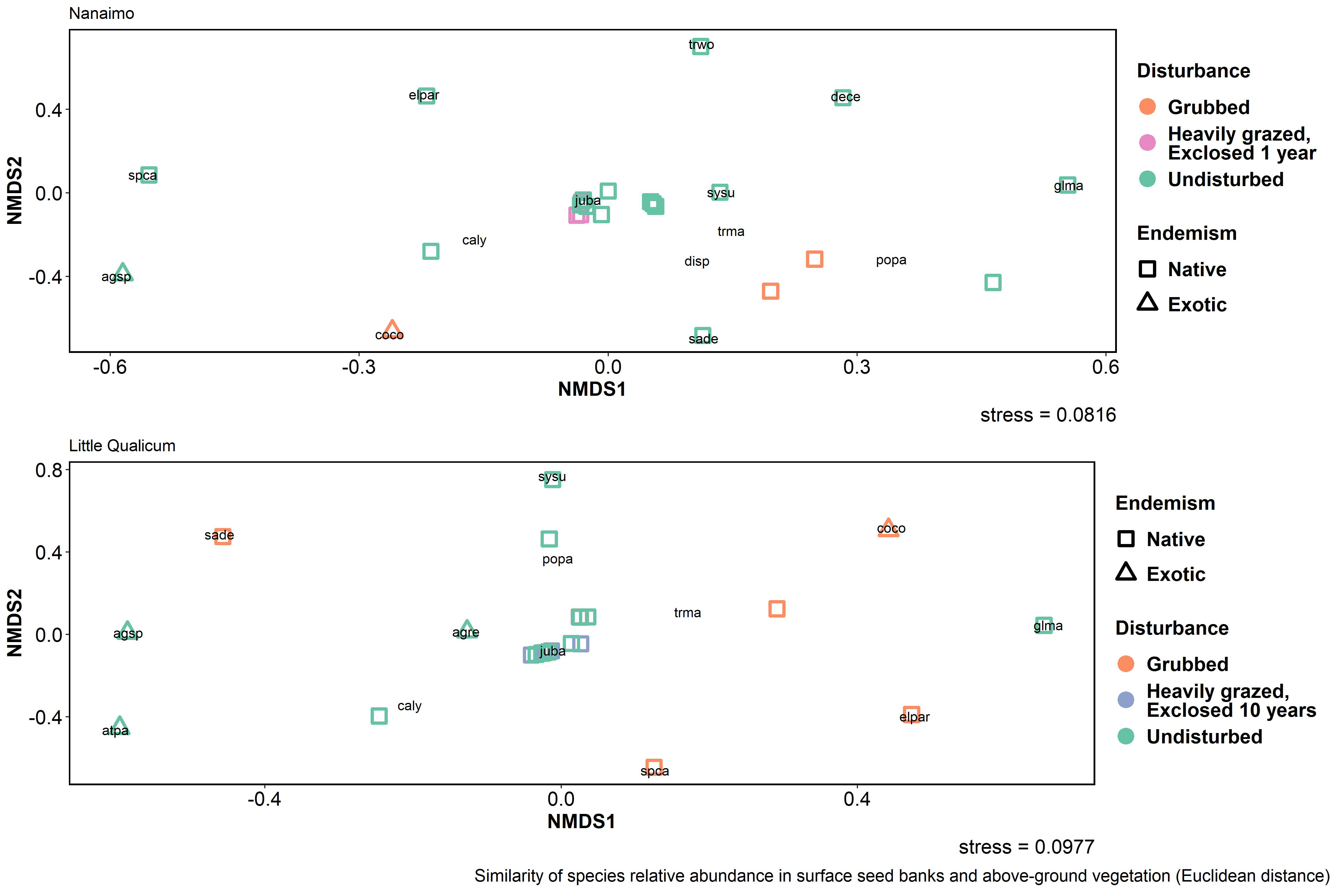



Slide 2
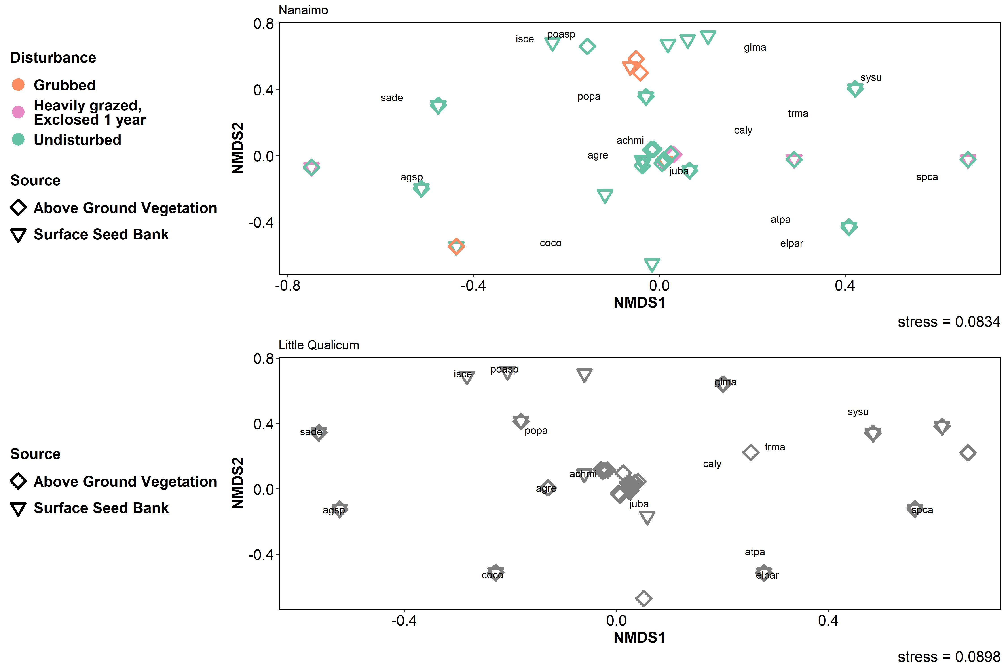
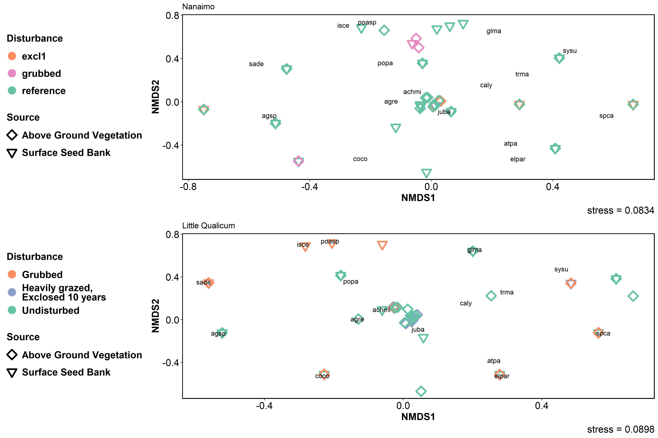

Slide 3
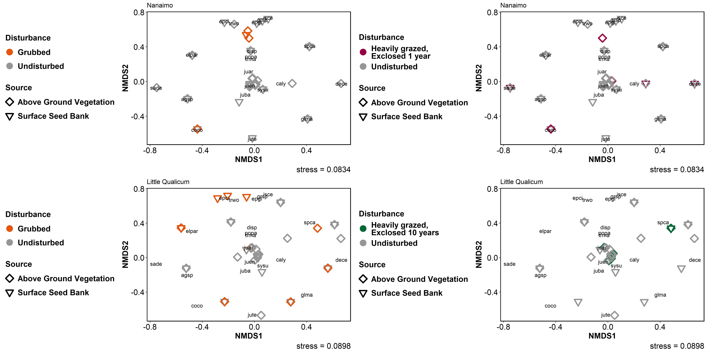


Slide 4
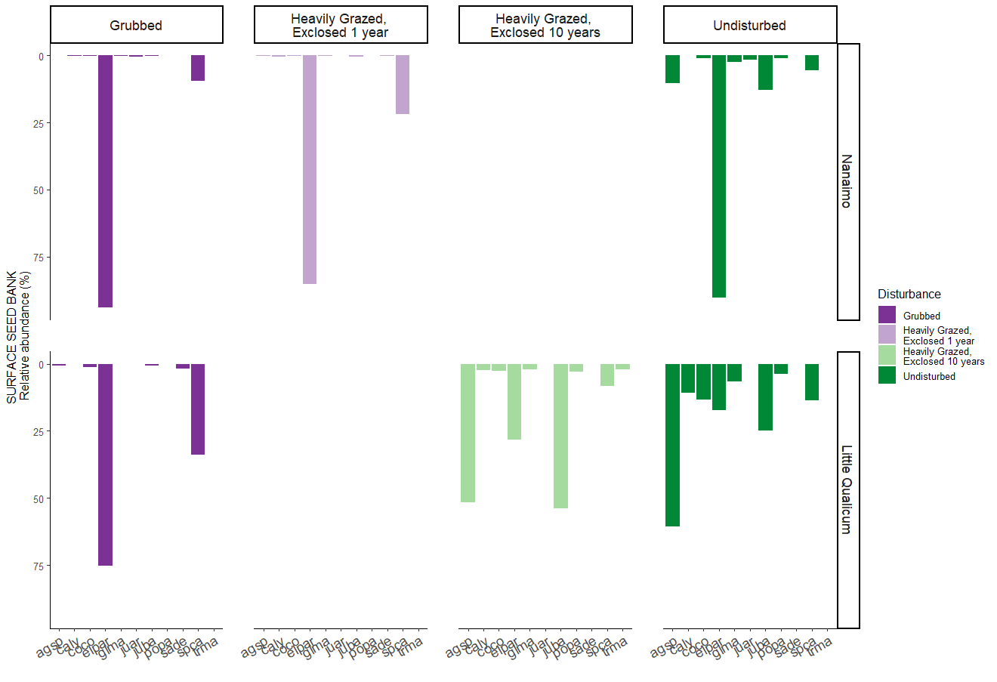

Slide 5
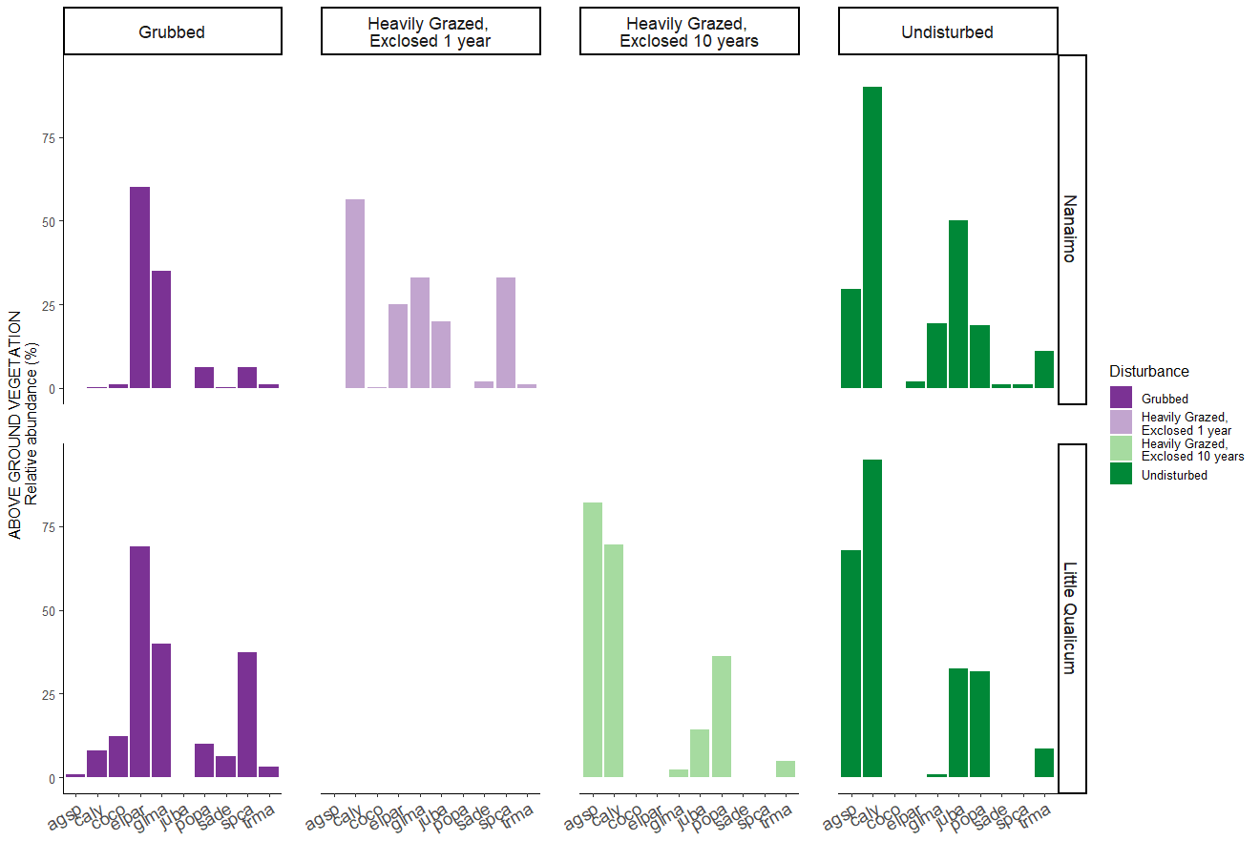

Slide 6
ABOVE GROUND VEGETATION
Relative abundance (%)
NANAIMO
ESTUARY
SURFACE SEED BANK
Relative abundance (%)

Slide 7
ABOVE GROUND VEGETATION
Relative abundance (%)
LITTLE QUALICUM
ESTUARY
SURFACE SEED BANK
Relative abundance (%)

